Slide 1


Qwickly App
Pardeep Kumar Zeeshan Hussain
Supervisor: Mr. Javed Ali Abbasi

Slide 2
Agenda of Presentation
Dynamic Structure of System
Modules
Conclusion
Future Work
References
Demo
Note of Thanks
Introduction
Problem
Solution
Benefits of our Solution
Product Features
Architecture
Tools & Technologies
Static Structure of System

Slide 3
Introduction
The Qwickly App is an Augmented Reality-based Android application for real time shopping experience for customers. Our product will save user’s time and provide an engaging shopping experience.

Slide 4
Problem
After entering shopping store, the customer needs to know every detail of every product he/she might buy, like price, size, color, material used, etc.
Without the intervention of the staff every time, it is not possible.
People get frustrated and also lose interest when they have to call every time the staff of store to ask about every product they are interested in.
Adding so, the product shop’s value and customer rate decreases due to incorrect information provided by the staff or when the customer queries are not properly entertained.
Notes:
When we visit store/mall, our primary concern is to know
Whether the product suits our needs or not.
One actually wishes to know the specifications of the product without being facilitated for each product he or she wants to know about.
The Customer service is often unsatisfactory and staff cannot engage every customer every time (peek hours).

Slide 5
Solution: Qwickly App
Ideally, a customer should have an app that can use Mobile Camera, image processing and Augmented Reality to create a user experience in which he/she can use the app to get all details about the product he/she is looking in real time and decide whether he/she wants to buy product or not.
There is what our Qwickly App is all about.
Context: For FYP purpose, we are targeting only Cloth Stores.

Slide 6
Why this Solution?
Provides Real time and engaging shopping experience
Facilitates in choosing the desired product(pents/shirts/suits) to buy
Saves customers time
Allows to save product in store for later view
Facilitates to buy the saved product online without going to store
Avail the latest offers and discounts provided by the stores
Increases sales and customer engagement
Reduces dependability on staff

Slide 7
Product Features
SCAN THE PRODUCT
allows the user to scan the barcode of product and launch AR display to get details in real time.
AR DISPLAY
to view the Augmented display of the product features.
VIEW DETAILS
details about the product that you are viewing real time and add to favorites for later view.
VIEW FAVORITES
to view the products that are saved in favorites and also buy the favorite product online.
OFFERS AND DISCOUNTS
to view the latest discount and offers provided by your favorite stores and avail them.

Slide 8

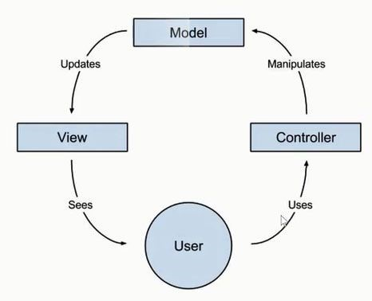
Application Architecture

Slide 9
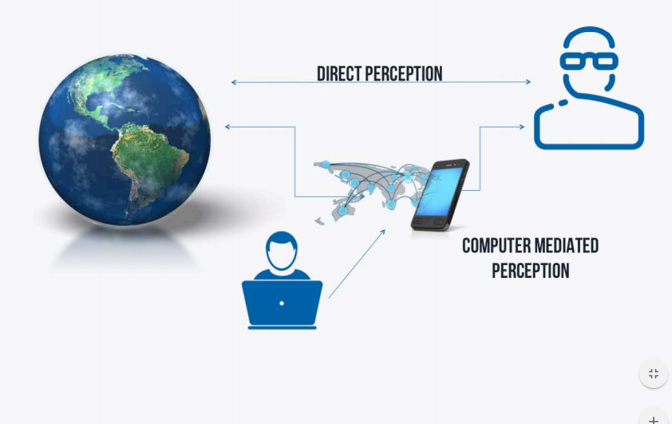
Augmented Reality System Architecture

Slide 10
Technologies and Tools Used
Technologies
Google Mobile Vision API
Vuforia Augmented Reality SDK
Google Firebase Authentication
Google Firebase Database
Google Play Services
Glide library
JSON tree
Tools
Android Studio
Sublime text
Visual Paradigm
Notes:
Google Mobile Vision API : to read barcode
Vuforia Augmented Reality SDK : for AR display
Google Firebase Authentication : for user login and authentication
Google Firebase Database : Database for product and user data
Android Studio : for backend and frontend development

Slide 11
Class Diagram

Slide 12
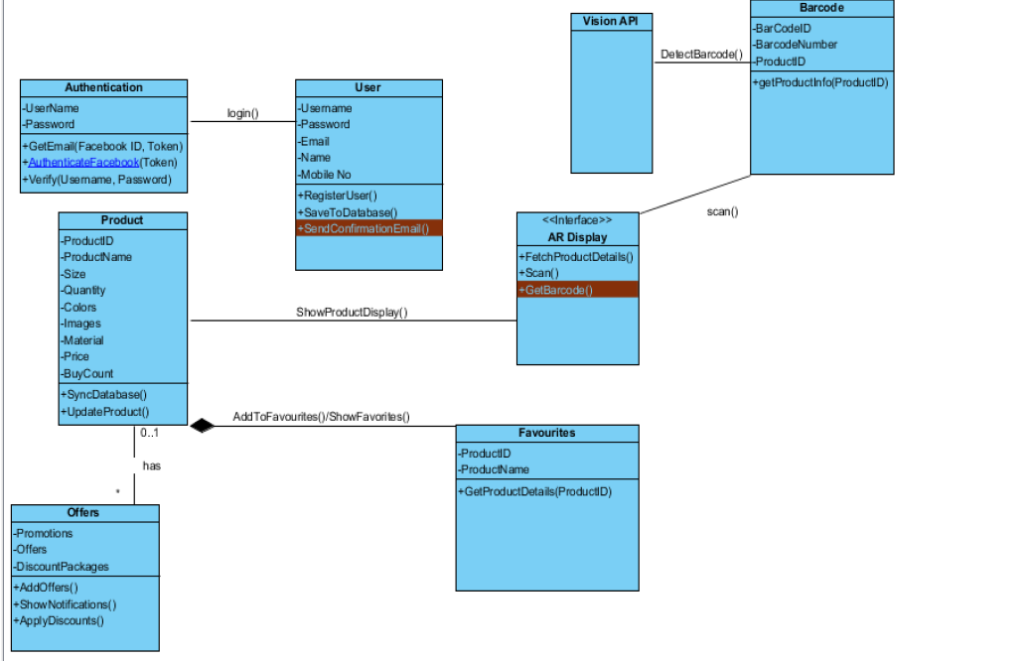

Slide 13
Sequence Diagram: Scan the Product

Slide 14
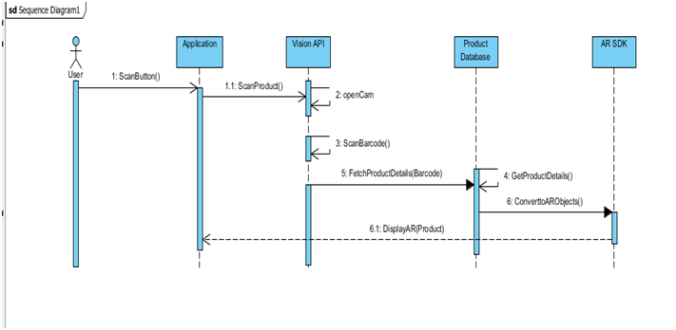

Slide 15
Modules with pictures

Slide 16
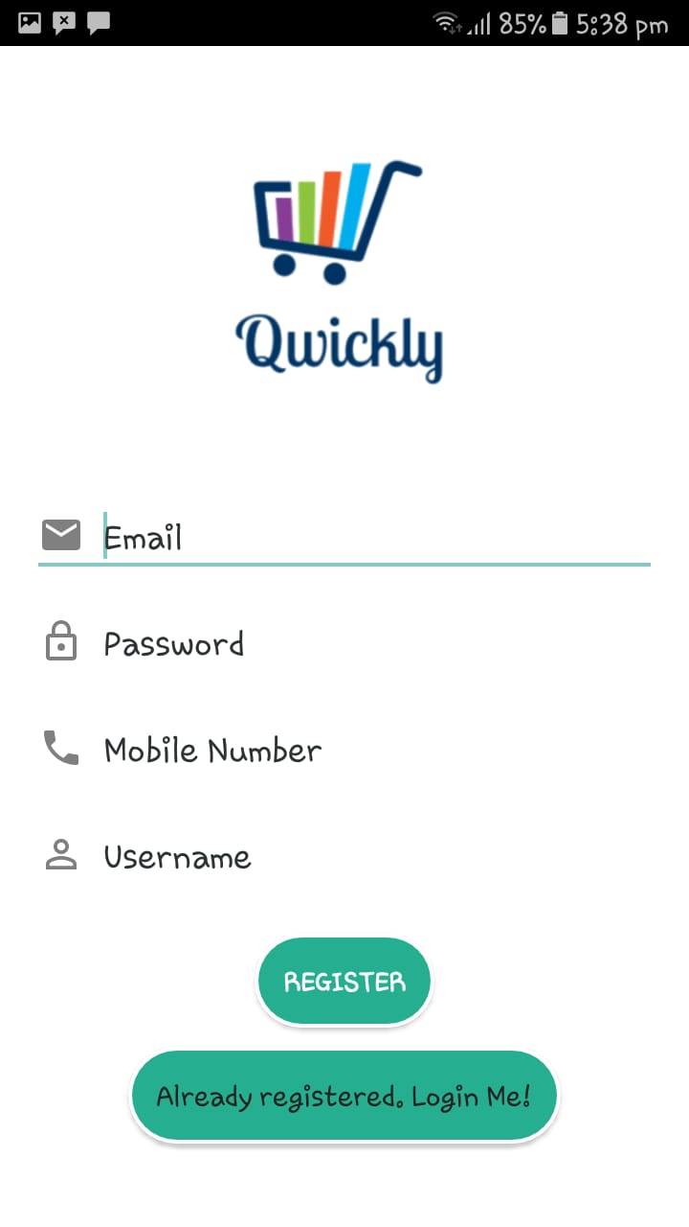
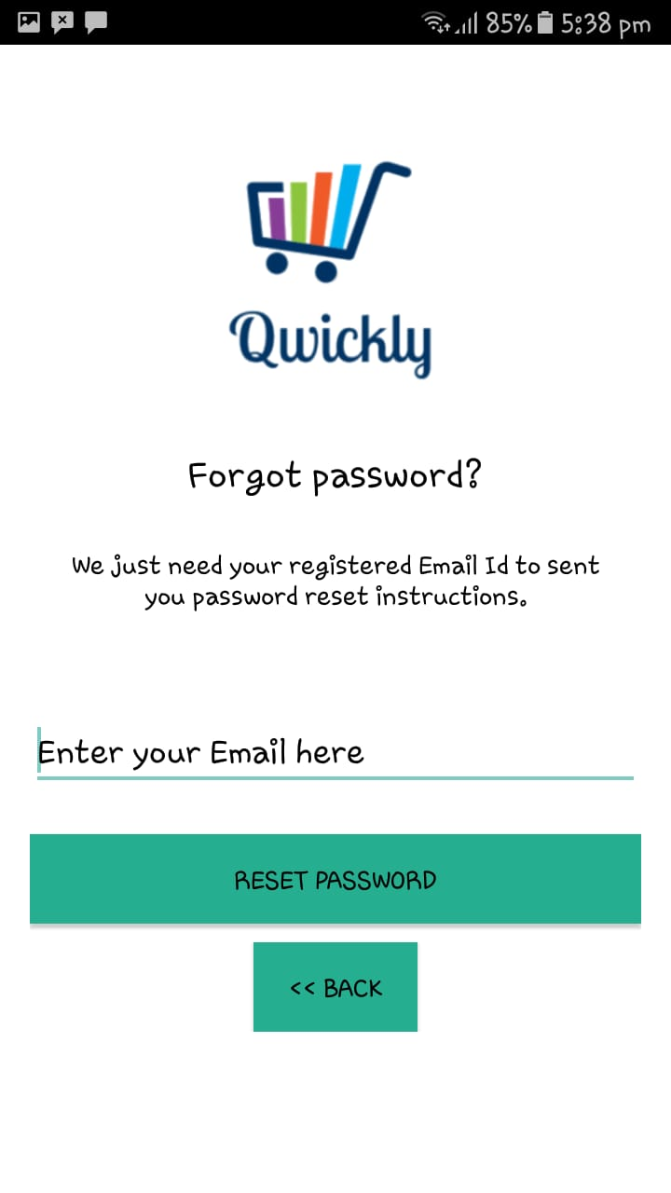
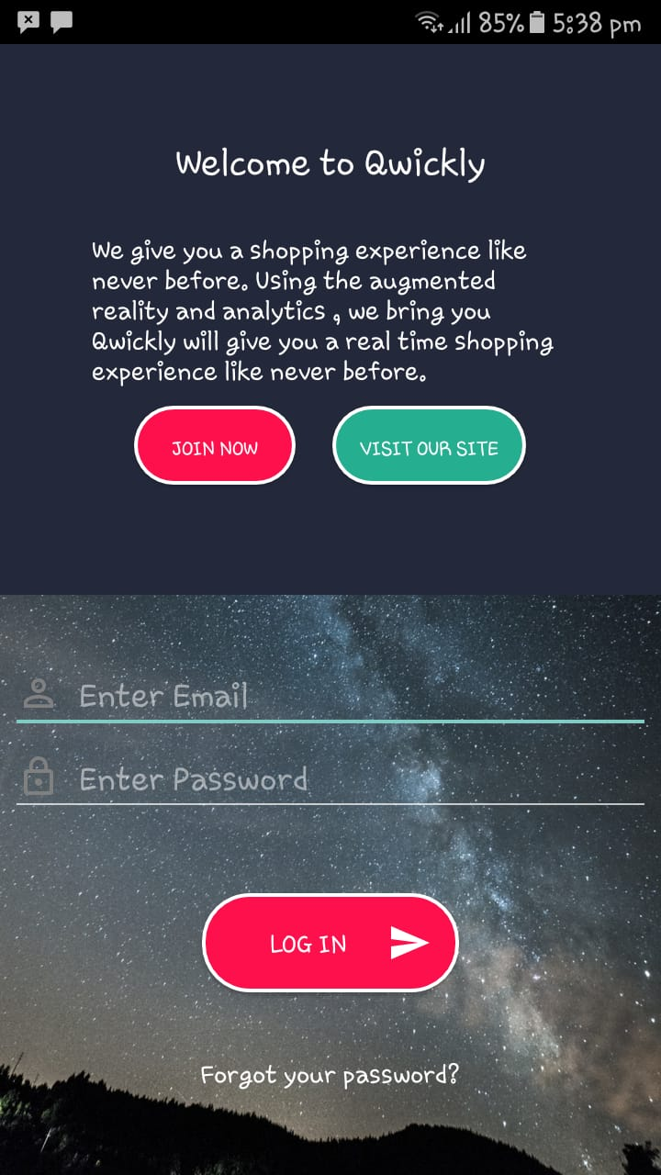
Module 1: User Login and Registration

Slide 17
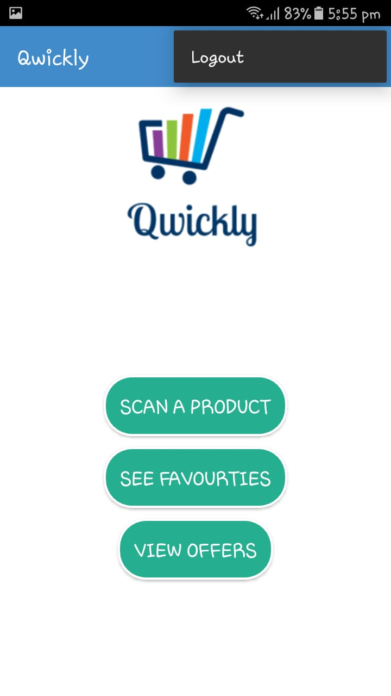
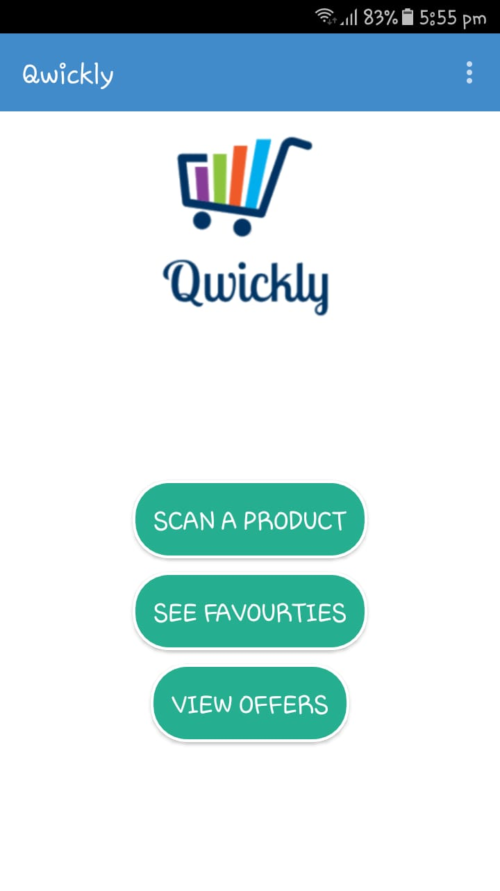
Module 2: Main Menu

Slide 18
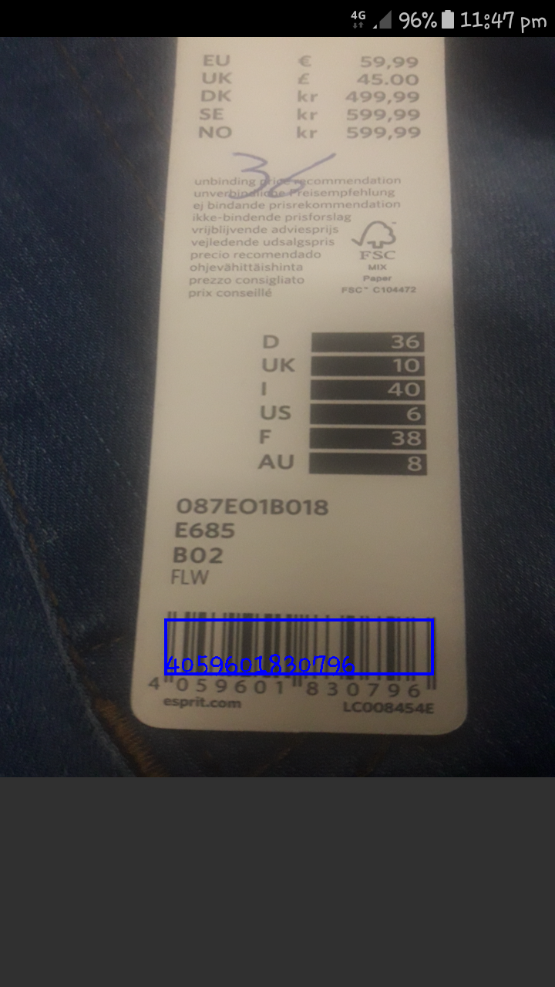

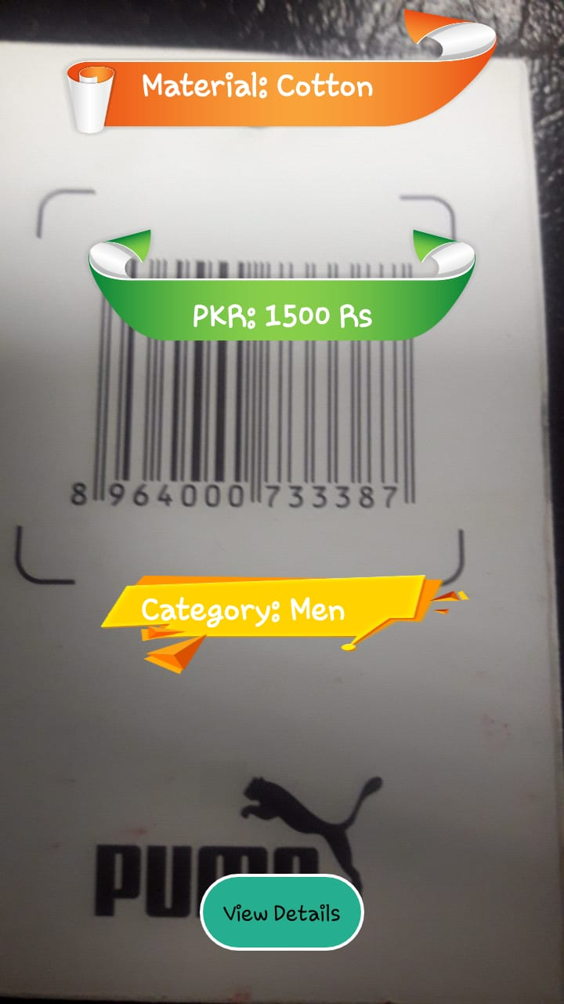
Module 3: Scan Product

Slide 19
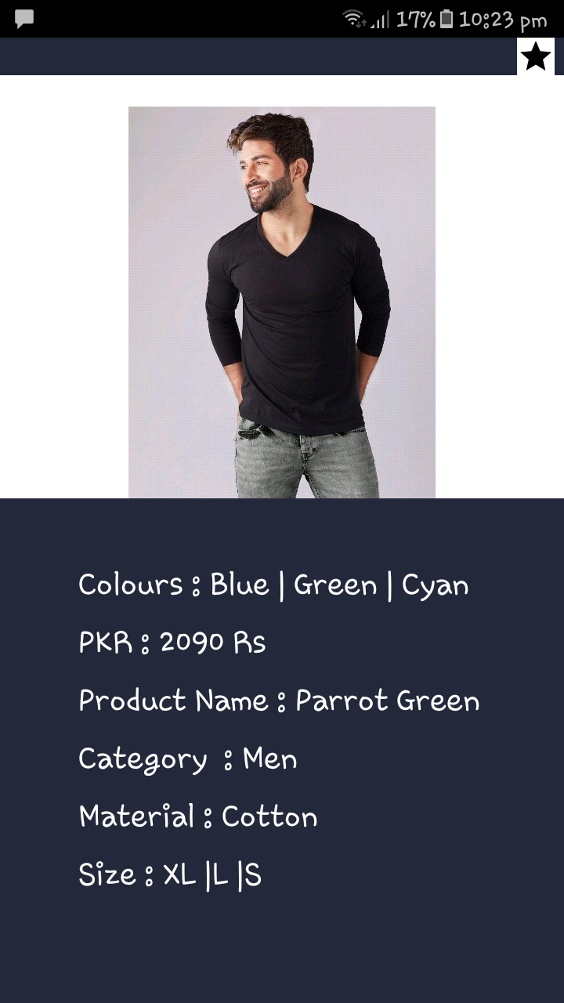
Module 4: View Details

Slide 20
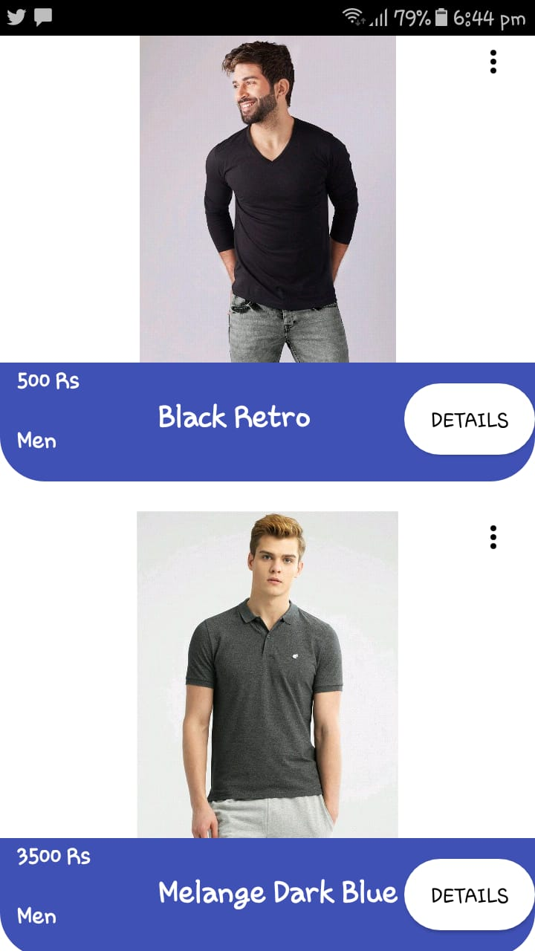
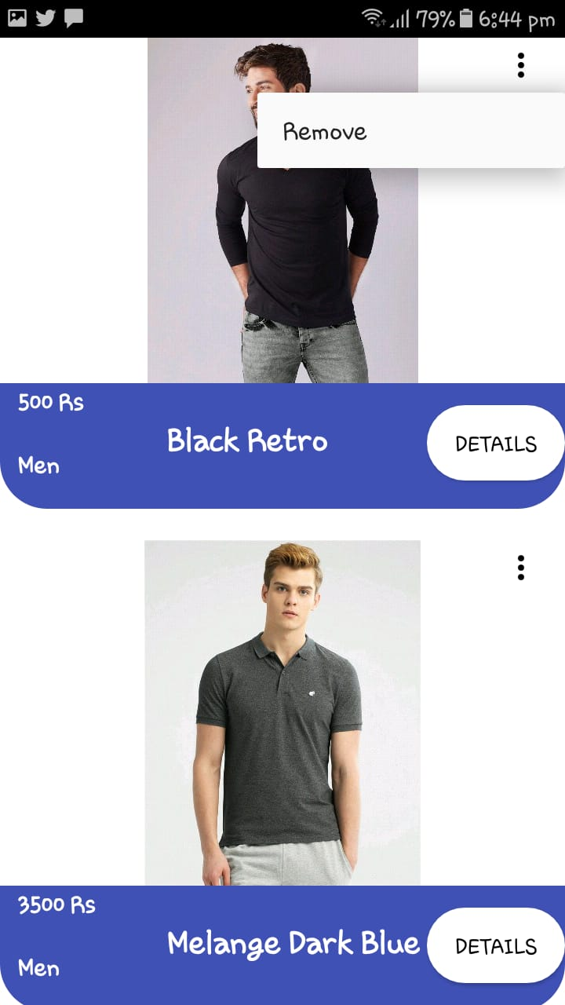
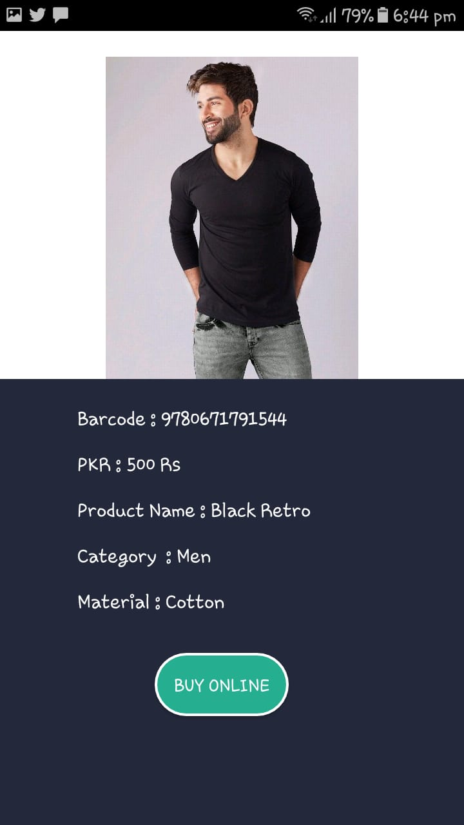
Module 5: View Favorites

Slide 21
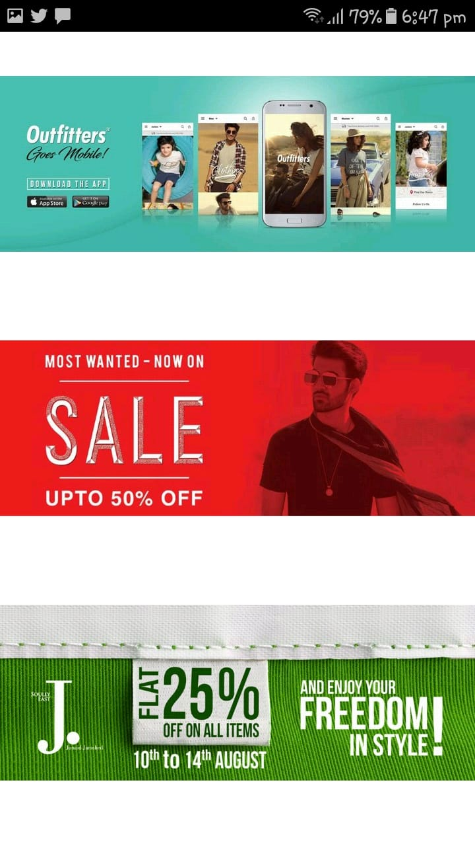
Module 6: View Offers

Slide 22
Conclusion
Augmented Reality is penetrating into every market
Qwickly is an effort of Augmented Reality in Retail and Shopping industry to enhance shopping experience of customers and facilitate them.
Qwickly app makes use of smartphones capabilities to make shopping an experience never to forget and increase the engagement between stores and their customers.
Notes:
we are moving towards a memorable and more engaged shopping experience

Slide 23
Future Work
Our FYP project is the first tip of an iceberg.
As applications of AR mobile technology in shopping is still novel, we are pretty much to be the first movers in the Pakistan’s growing market.
The future work of Qwickly includes the following tasks and features:
Extend the app for other products(shoes, books etc.)
Introduce the geo-location-based AR experience to make the app a one to go for shopping malls
Extend the app to pay bills for purchasing there.

Slide 24
References of Tools/Technologies
Vuforia | Augmented Reality", Vuforia.com, 2017. [Online]. Available: https://www.vuforia.com/. [Accessed: 02- Oct- 2017].
“10 best augmented reality sdk for ar development in 2017", Thinkmobiles, 2017. [Online]. Available: https://thinkmobiles.com/blog/best-ar-sdk-review/. [Accessed: 02- Oct- 2017].
Coursera. (2018). Getting started with Augmented Reality | Coursera. [online] Available at: https://www.coursera.org/learn/augmented-reality [Accessed 15 Jul. 2018].
Zeeshan and Pardeep (2018) SRS Document Version 2.0.
Vuforia : https://developer.vuforia.com
Vuforia Fusion Supported Devices: https://library.vuforia.com/articles/Solution/vuforia-fusion-supported-devices.html

Slide 25
Note of Thanks
We are thankful to our supervisor Mr. Javed Ali Abbassi for his continuous support and dedication to the project.
We are thankful to CS dept , Coordinator (Dr Ahsanuallah Abro) and our own Head of Department (Prof Dr Abdul Rehman Soomrani) for their facilitation throughout this FYP period.

Slide 26
DEMO OF PROJECT

